Slide 1
Project Management for Game Designers
TVGS Uplift October 2018
Suzanne Dondero
https://www.linkedin.com/in/suzannedondero/

Slide 2
Agenda
Who am I?
What is project management?
Should game designers spend time on project management?
Agile Project Lifecycle
How to implement Agile methods that work for you.
Project management tools
Activity

Slide 3
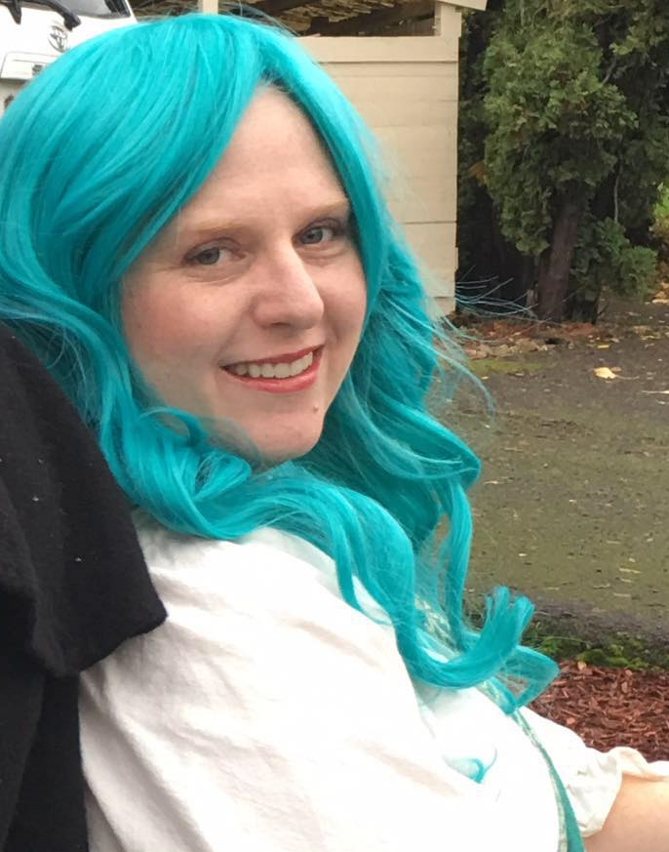
Who am I?
Notes:
Kind of like an AA meeting…My name is Suzanne and I’m a project manager. I am that strange person who actually enjoys handling the organization and planning of projects, and ultimately working to motivate a team to achieve goals. My family moved to the east coast a little over a year and half ago from near Portland, OR and I confess that I miss Oregon a great deal.
I’ve been in project management since 1998. I started in the construction world at Intel’s Fab 18 located in Qiryat Gat Israel, moved back to the US in 2000 and worked on my first software project in 2004. We used a form of Agile called Xtreme programming where every morning at 3:00 am I would meet with my technical PM and a team of Russian programmers to review what had been accomplished, lay out what needed to be tested, and determined what would be accomplished by the next day. The project was a resounding success and I have been told that some version of it is in use managing the bi-annual operational capital process at Intel to this day.
In 2005 I took time away from the workplace to be with my kids but by 2009 was feeling antsy so I started my own business helping small businesses with everything from data analysis to documentation to word press websites. In 2014 I took a full time position with a fully distributed software company as a project coordinator and then worked my way to project manager. After an unfortunate lull in business led to me being laid off in 2017, I took a project management position with a company upstairs where I had the opportunity to work with Taro, our wonderful executive director at TVGS.
Currently I am going back to school so I can finish up my PMP certification and am looking to either start up my business as a project management consultant or find a great distributed team to work with again.

Slide 4
What is project management?
Boiled down, project management is the planning and organization that supports the work being done.
  Organizes and schedules tasks.
  Interfaces with stakeholders and facilitates communication throughout the project lifecycle.
  Monitors a project to ensure it is on track.
Notes:
Breaks down an initial design document into manageable tasks, works with development to refine and estimate those tasks.
Based on the task break down and estimates, creates a project schedule
Monitors and encourages the team, helps resolve roadblocks.
Facilitates planning and feedback sessions
Provides report outs to the team and management on progress

Slide 5
Should game designers spend time on project management?
YES! But why….
  Start good habits that will follow you into the workplace, or even into your own startup.
  Learn to be honest with yourself about levels of effort required.
  Set real goals and then work to achieve them, helping to avoid burn out.
  Ultimately publish your game.
  “A goal without a plan is just a wish.”
  ― Antoine de Saint-Exupéry author of A Little Prince
Notes:
I know what some of you are thinking – I want to design beautiful games with meaning and art…not deal with paperwork. And you have something of a point.
When I was at SitePen, one of the most important lessons I learned was to shield the developers from things that took them away from actual development as much as possible. Development skills are a precious resource to be guarded, not spent on organizing tasks or dealing with the whims of customers. Project Managers were to be the fire wall between the outside world and developer work.
However, as indie game developers just starting out, having a person who handles the non-development work is highly unlikely. That means you will need to take care of it yourself.
Breaking down your project into a project plan allows you to set mini goals or milestones along the way to celebrate. Most software projects are more of a marathon than a sprint – in spite of the fact that we do them in sprints – and this is particularly true when you are talking about passion projects that are not a part of your day job. Burn out is a real thing as I know many here can attest. One thing you can do to minimize that is to lay out achievable plans.
Taking the time to lay out the plan of what your next iteration will be, what you need to do to get there and then being able to watch yourself work through that to release is satisfying. Without the plan, you will have a tangle of things to do an no way to really acknowledge what has been accomplished as well as what is next.

Slide 6
Agile Project Lifecycle
Iteration
Initiation
Feedback
Planning
Release
Production
Testing
Sprint

Slide 7
How to implement Agile methods that work for you.
Find the balance of process to flexibility that works for you.
  Sprints can run anything between 2 – 6 week cycles. What timeframe makes sense for you?
  Set appointments with yourself for the planning and feedback stages. Take the time to plan your next sprint and to perform a retrospective on what went well with your work process last time along with what can be improved.
Roll with the punches
  You may find halfway through your sprint that your plan needs to be reduced. This is okay. However, if you find yourself wanting to add to your plan, resist the urge. Instead, complete your plan as it stands early if you can and incorporate the add to the next sprint.

Slide 8
A word about teams
Using a project management app becomes more important as you form a team.
Developing consistent work processes and holding regularly scheduled standups / planning sessions / retrospectives will help the team stay on track
As your team grows and becomes more of a start up, you may want to consider bringing on a project manager to ensure that the team is not exhausting itself on administrative tasks instead of focusing on the work at hand.
Notes:
Knowing who is working on what helps with accountability and reduces confusion
The ability to easily document questions, answers and other communication on a card makes it much easier for the whole team to follow along.
Distributed teams will often be working at different times. Enabling asynchronous communication is vital

Slide 9
Project management tools
Spreadsheets
Trello vs Asana
  Gantts for Trello: https://elegantt.com/
  Gantts for Asana: https://instagantt.com/
Notes:
There are MANY project management programs out there but for the purposes of this exercise I wanted to keep it simple and free.
Spreadsheets like google sheets or excel can work – but they are limited in the levels of collaboration and visual appeal
Trello and Asana are both viable tools to use for software project management, they both have free versions and allow the user to create Kanban style boards.
If you do not like the Kanban style, Asana offers sectioned lists instead of boards, however I noticed that the Trello checklist system on a card is far easier to use than Asana subtasks. Really it comes down to personal preference and what you like better.
As a PM, I like having the ability to see timelines, both apps have extensions that allow for that. I have not played with the Trello gantt extension, but Instagantt allows you to enter time estimates in Asana without having premium and then maps that information to a resource loaded schedule so you can see how many hours per day something would need to be worked on in order to complete it by a certain date. This is particularly useful when creating a schedule.

Slide 10
Activity – Project Plan
In a spreadsheet, on a piece of paper or in the application of your choice:
  Break out your design into bite sized tasks. Provide an estimate of how many hours the task should take. Ideally, each task will be no more than 6 hours of work. If the task is larger than that, consider if it should be broken into smaller pieces.
    For example, if Program Level 1 would take 20 hours maybe it could be broken down into Program obstacle 1, obstacle 2, obstacle 3 etc. as separate items.
Organize your tasks in a way that makes sense to you
Look at the entirety of your estimate, is the scope you have established reasonable to achieve within the parameters of this program? If it is not, what can you change to make it work?

